Slide 1
Networking
Lecture 6
Tom Karni, Itsik Avidan

Slide 2

Intro
Cellular
Data :
3G
Wi-Fi
Bluetooth
N.F.C

Slide 3
Permissions
To allow network resources the AndroidManifest must declare the <uses-permission> Tag

Slide 4
Socket – Reminder
Combination of an IP address and a Port number
Client :
Initiate a TCP / UDP connection to the Server by creating a Socket
Specify the Server’s IP & Port number
Server:
Welcome Socket
Connection Socket – dedicated to the particular client

Slide 5
Java socket programming
Android contains the Java.net.* package
Allows to access network resources
TCP – Socket.class
UDP – DatagramSocket.class
Development such as any other Java client code

Slide 6
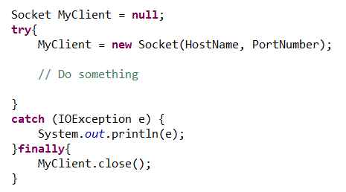
Java socket programming

Slide 7
Http – Reminder
Hypertext Transfer Protocol – application protocol for distributed, collaborative information systems
Common request methods :
GET
POST
PUT
DELETE

Slide 8
HttpClient
Android contains the Apache’s HttpClient library
Interface for an HTTP client
Required to execute HTTP requests while handling cookies, authentication, connection management, and other features
Thread safety of HTTP clients depends on the implementation and configuration of the specific client

Slide 9
Handlers
Network operation should run asynchronously to prevent block of the UI thread
Handler.class can update the UI
Provides methods for receiving instances of messages and allows to transfer data between the threads

Slide 10
References
Android developers [http://developer.android.com]
SQLite [http://www.sqlite,org/]
W.Frank Ableson, Robi Sen, Chris King. “Android in Action, 2nd edition”, 2011.

